Slide 1


Presentation on: Preliminary Project Report
A research and development based project…
Notes:
NOTE:
To change the image on this slide, select the picture and delete it. Then click the Pictures icon in the placeholder to insert your own image.

Slide 2

Presented by-
M. A. Nur Quraishi
Roll: BSSE-0615
BSSE 6th Batch
IIT, DU
Supervised by-
Rayhanur Rahman
Lecturer at
IIT, DU

Slide 3
Project Name
Recovering Documentation-to-Source-Code Traceability Links using Latent Semantic Indexing

Slide 4
Contents
Introduction
Background Study
Literature Review
Problem Specification
Tentative Solution
References
Question Session

Slide 5
Introduction
Going to implement an existing work or method
Previously analyzed by Andrian Marcus and Jonathan I. Maletic from Department of Computer Science, Kent State University, Kent Ohio
An information retrieval (IR) mechanism
Used to automatically identify the traceability links from system documentation to program source code
Purposes:
general maintenance tasks
impact analysis
program comprehension
reverse engineering for redevelopment
systematic reuse

Slide 6
Background Study
Vector Space Model:
Widely used classic method for constructing vector representations for documents
Encodes a document collection by a term-by-document matrix
[i, j]^{th} element indicates the association between the i^{th} term and j^{th} document
Term: phrases or word or character n-grams
Document: paragraphs, sequences of n consecutive characters, or sentences
Measured by explicit evidence based on term occurrences in the documents
Similarity measure: the cosine or inner product between the corresponding vectors [-1, 1]

Slide 7
Background Study (Continued)
Latent Semantic Indexing:
VSM based method
Representing aspects of the meanings of words and passages reflective in their usage
Not only captures significant portions of the meaning of individual words but also of whole passages such as sentences, paragraphs, and short essays
Central concept:
Information about word contexts in which a particular word appears, or does not appear
Provides a set of mutual constraints that determines the similarity of meaning of sets of words to each other
Uses a user-constructed corpus to create a term-by-document matrix

Slide 8
Background Study (Continued)
Singular Value Decomposition:
Applied by LSI to the term-by-document matrix
To construct LSI subspace
Term combinations which are less frequently occurring in document collection tend to be precluded
Noise reduction approach: less frequently co-occurring terms - less mutually-related and less sensible
Mathematical Equation: X = UΣV^{T}
X = Rectangular (t x d) matrix
U = Left singular vectors (t x k)
Σ = Diagonal matrix (k x k) [contains singular values in decreasing order]
V = Right singular vectors (k x d)
*k = dimension or concept or factor of LSI space

Slide 9
Literature Review
“An Information Retrieval Approach for Automatically Constructing Software Libraries” by Maarek and others:
Knowledge-based approach
Typically related to indexing reusable components
IR approach for automatically constructing software libraries
Construction of libraries done in 2 stages.
Stage 1: Set of attributes or profile extracted from natural language document by using Lexical Affinty
Stage 2: Classifying the objects or components such that same class share some set of property

Slide 10
Literature Review
“Supporting Program Comprehension Using Semantic and Structural Information ” by Marcus, A., & Maletic, J. :
Used LSI to derive semantic similarity measures between source code elements
Used Mosaic approach to derive structural similarity measure of source code elements
These measures used to –
Cluster the source code to identify of abstract data types in procedural code and concept clones
Define a cohesion metric for components

Slide 11
Literature Review
“Recovering traceability links between code and documentation ” by Antoniol, G., Canfora, G., Casazza, G., & De Luc, A. :
Used VSM and probabilistic approach to identify the traceability link
Supports the choice of VSM over probabilistic IR

Slide 12
Problem Specification
VSM does not take account of relations between terms
VSM produces zero similarity between documents that share no terms
Other IR methods (i.e., probabilistic, natural language processing, knowledge based) –
Complex and inefficient
Low cost effectiveness and inflexible
Enormous amount of input preprocessing
Predefined vocabulary or grammar reliable
More time consuming

Slide 13
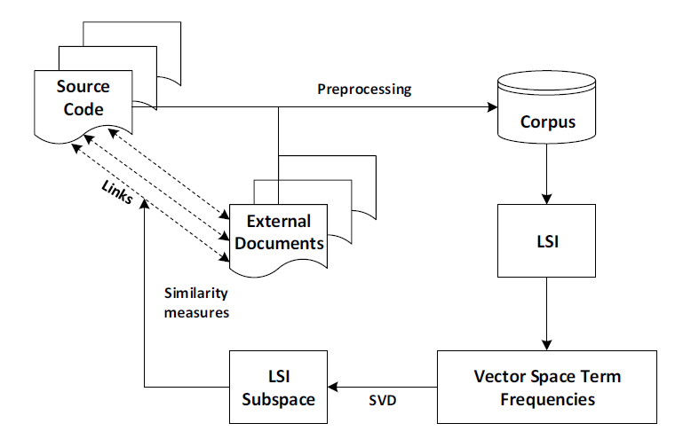
Tentative Solution

Slide 14
References
Marcus, A., & Maletic, J. (2003). Recovering Documentation-to-Source-Code Traceability Links using. ICSE '03 Proceedings of the 25th International Conference on Software Engineering (pp. 125-135). Portland, Oregon: IEEE Computer Society Washington, DC, USA. Retrieved August 4, 2017 (Base paper)
Deerwester, S., Dumais, S., Furnas, G., Landauer, T., & Harshman, R. (1990). Indexing by Latent Semantic Analysis". American Society for Information Science. Retrieved October 12, 2017
Maarek, Y., Berry, D., & Kaiser, G. (1991). An Information Retrieval Approach for Automatically Constructing Software Libraries. IEEE Transactions on Software Engineering, 17(8), 800-813. Retrieved October 3, 2017
Marcus, A., & Maletic, J. (2001). Supporting Program Comprehension Using Semantic and Structural Information. 23rd International Conference on Software Engineering (ICSE 2001) (pp. 103-112). Toronto, Ontario, Canada: ICSE. Retrieved September 27, 2017
Antoniol, G., Canfora, G., Casazza, G., & De Luc, A. (2002, October). Recovering traceability links between code and documentation. IEEE Transactions on Software Engineering, 28(10), 970 - 983. Retrieved September 12, 2017

Slide 15

Question Session

Slide 16
Thank You!!!

